Slide 1
联想面向SAP HANA的解决方案
2015年9月

Slide 2
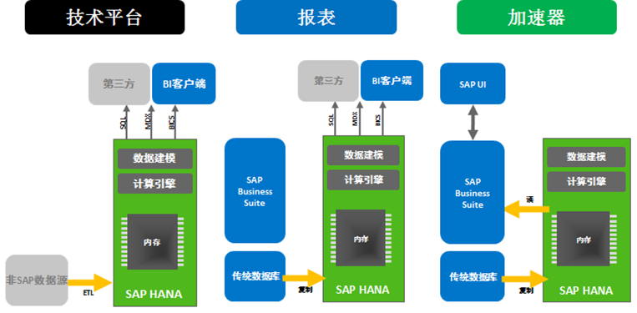
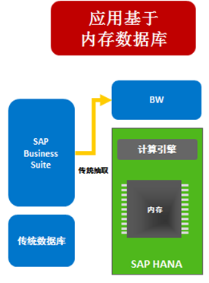
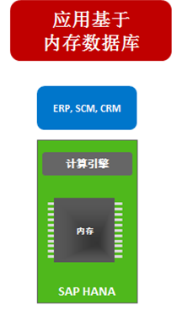
Lenovo面向SAP HANA™解决方案的部署场景
场景一：Datamart 数据集市
场景二：BW on HANA
场景三 ：Suite on HANA (SoH)
独立的技术平台/SAP报表功能/SAP应用的加速器（数据模型在HANA中完成）
作为BW（数据仓库）的分析型数据库（数据模型在BW中完成）
SAP Business Suite商务套间 (包括ERP/CRM/SCM/SRM) on HANA，用HANA替换传统交易型数据库，
受SAP软件技术限制，未经SAP批准不能做节点集群扩展
HANA不同的部署场景有不同的适用机型和架构方案
备注：ERP(Enterprise Resource Planning企业内部管理所需的业务应用系统，主要是指财务、物流、人力资源等核心模块), CRM (Customer Relationship Management客户关系管理), SCM (Supply Chain Management供应链管理), SRM (Supplier Relationship Management供应商管理)

Slide 3
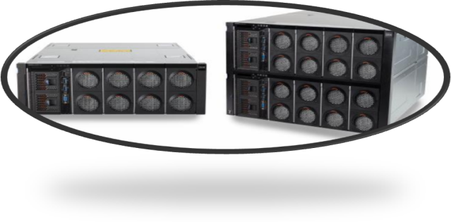
联想面向SAP HANA的一体机解决方案
什么是SAP HANA
是软件硬件服务于一体的内存数据库解决方案
应用（ERP/CRM/BW等）
SAP HANA®
特性（Feature）：
优化的一体机方案
利用IBM GPFS并行文件系统
基础架构的可靠性，可扩展性，高可用性
GPFS
优势（Advantage）：
最大的集群规模
提供Lab Service原厂实施服务
全球全国一半的市场占有率
FPO功能
OS
Red Hat Enterprise Linux 6.5
SUSE Linux Enterprise Server 11
面向SAP应用的优先支持
SUSE
用户带来的好处（Benefit）：
最大的业务数据支持能力
无需集中式共享存储，GPFS灵活的扩展能力
快速部署，低维护成本
服务器硬件
X6 - x3850 X6 和 x3950 X6

Slide 4
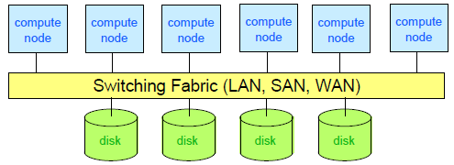
什么是GPFS
GPFS是可扩展的、并行化的、高可用的、高性能的文件系统
群集：数千个节点、快速可靠的通信、通用管理域
共享磁盘：用户可在分布式锁定服务的协调之下从任何阶段接入磁盘上面所有的数据和元数据
并行：数据和元数据在所有节点及所有磁盘之间并行流动；文件分布在所有磁盘上

Slide 5
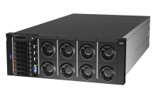
Lenovo Solution for SAP HANA with X6 适用场景：Datamart, BW, and Suite on HANA scenarios，单节点或双机HA/DR
128GB | 256GB | 384GB | 512GB | 768GB | 1024GB* | 1536GB* | 2048GB* (available under relaxed HW requirements) | 3072GB* (available under relaxed HW requirements)
x3850 X6 | x3850 X6 | x3850 X6 | x3850 X6 | x3850 X6 | x3850 X6 | x3850 X6 | x3850 X6 | x3850 X6
6241-AC3 | 6241-AC3 | 6241-AC3 | 6241-AC3 | 6241-AC3 | 6241-AC3 | 6241-AC3 | 6241-AC3 | 6241-AC3
AC32H128S | AC32H256S | AC32H384S | AC32H512S | AC32H768S | AC32H1024S | AC32H1536S | AC32H2048S | AC32H3072S
Standalone | Standalone | Standalone | Standalone | Standalone | Standalone | Standalone | Standalone | Standalone
2x E7-8880v3 | 2x E7-8880v3 | 2x E7-8880v3 | 2x E7-8880v3 | 2x E7-8880v3 | 2x E7-8880v3 | 2x E7-8880v3 | 2x E7-8880v3 | 2x E7-8880v3
128GB DDR3/4 (16x 8GB) | 256GB DDR3/4 (16x 16GB or 32x 8GB) | 384GB DDR3/4 (48x 8GB) | 512GB DDR3/4 (32x 16GB or 16x 32GB) | 768GB DDR3/4 (48x 16GB) | 1TB DDR3/4 (32x 32GB or 16x 64GB) | 1.5TB DDR3/4 (48x 32GB) | 2TB DDR3/4 (32x 64GB) | 3TB DDR3/4 (48x 64GB)
6x1.2TB HDD 2x400GB SSD | 6x1.2TB HDD 2x400GB SSD | 6x1.2TB HDD 2x400GB SSD | 6x1.2TB HDD 2x400GB SSD | 15x1.2TB HDD 4x400GB SSD | 15x1.2TB HDD 4x400GB SSD | 15x1.2TB HDD 4x400GB SSD | 15x1.2TB HDD 4x400GB SSD | 15x1.2TB HDD 4x400GB SSD
1x M5210 | 1x M5210 | 1x M5210 | 1x M5210 | 1x M5210 1x M5225 | 1x M5210 1x M5225 | 1x M5210 1x M5225 | 1x M5210 1x M5225 | 1x M5210 1x M5225
3.6TB RAID5 data/log | 3.6 TB RAID5 data/log | 3.6 TB RAID5 data/log | 3.6 TB RAID5 data/log | 13.2 TB RAID5 data/log | 13.2TB RAID5 data/log | 13.2TB RAID5 data/log | 13.2TB RAID5 data/log | 13.2TB RAID5 data/log
4x 10GbE 4x 1GigE | 4x 10GbE 4x 1GigE | 4x 10GbE 4x 1GigE | 4x 10GbE 4x 1GigE | 4x 10GbE 4x 1GigE | 4x 10GbE 4x 1GigE | 4x 10GbE 4x 1GigE | 4x 10GbE 4x 1GigE | 4x 10GbE 4x 1GigE
Upgrade Options: 128 → 256 | Upgrade Options: 256 → 512 256 → 384 2S → 4S | Upgrade Options: 2S → 4S/512 | Upgrade Options: 512 → 768 512 → 1T 2S → 4S | Upgrade Options: 2S → 4S/1.5T | Upgrade Options: 1T → 1.5T 1T → 2T 2S → 4S | Upgrade Options: 2S → 4S/3T | Upgrade Options: 2T → 3T 2S → 4S | Upgrade Options: -
注：必须同时包含初始安装服务
* For Suite on HANA only, not for Datamart and BW

Slide 6
Lenovo Solution for SAP HANA with X6 适用场景：Datamart, BW, and Suite on HANA scenarios，单节点或双机HA/DR
256GB | 512GB | 768GB | 1TB | 1.5TB | 2TB* | 3TB* | 4TB* (available under relaxed HW requirements) | 6TB* (available under relaxed HW requirements)
x3850 X6 | x3850 X6 | x3850 X6 | x3850 X6 | x3850 X6 | x3850 X6 | x3850 X6 | x3850 X6 | x3850 X6
6241-AC3 | 6241-AC3 | 6241-AC3 | 6241-AC3 | 6241-AC3 | 6241-AC3 | 6241-AC3 | 6241-AC3 | 6241-AC3
AC34H256S | AC34H512S | AC34H768S | AC34H1024S | AC34H1536S | AC34H2048S | AC34H3072S | AC34H4096S | AC34SH144S
Standalone | Standalone | Standalone | Standalone | Standalone | Standalone | Standalone | Standalone | Standalone
4x E7-8880v3 | 4x E7-8880v3 | 4x E7-8880v3 | 4x E7-8880v3 | 4x E7-8880v3 | 4x E7-8880v3 | 4x E7-8880v3 | 4x E7-8880v3 | 4x E7-8880v3
256GB DDR3/4 (32x 8GB) | 512GB DDR3/4 (32x 16GB or 64x 8GB) | 768GB DDR3/4 (96x 8GB) | 1 TB DDR3/4 (32x 32GB or 64x 16GB) | 1.5 TB DDR3/4 (96x 16GB) | 2 TB DDR3/4 (32x 64GB or 64x 32GB) | 3 TB DDR3/4 (96x 32GB) | 4 TB DDR3/4 (64x 64GB) | 6 TB DDR3/4 (96x 64GB)
6x1.2TB HDD 2x400GB SSD | 6x1.2TB HDD 2x400GB SSD | 15x1.2TB HDD 4x400GB SSD | 15x1.2TB HDD 4x400GB SSD | 15x1.2TB HDD 4x400GB SSD | 15x1.2TB HDD 4x400GB SSD | 24x1.2TB HDD 4x400GB SSD | 24x1.2TB HDD 4x400GB SSD | 33x1.2TB HDD 6x400GB SSD
1x M5210 | 1x M5210 | 1x M5210 1x M5225 | 1x M5210 1x M5225 | 1x M5210 1x M5225 | 1x M5210 1x M5225 | 1x M5210 1x M5225 | 1x M5210 1x M5225 | 1x M5210 2x M5225
3.6 TB RAID5 data/log | 3.6 TB RAID5 data/log | 13.2TB RAID5 data/log | 13.2TB RAID5 data/log | 13.2TB RAID5 data/log | 13.2TB RAID5 data/log | 22.8 TB RAID5 data/log | 22.8 TB RAID5 data/log | 32.4 TB RAID5 data/log
4x 10GbE 4x 1GigE | 4x 10GbE 4x 1GigE | 4x 10GbE 4x 1GigE | 4x 10GbE 4x 1GigE | 4x 10GbE 4x 1GigE | 4x 10GbE 4x 1GigE | 4x 10GbE 4x 1GigE | 4x 10GbE 4x 1GigE | 4x 10GbE 4x 1GigE
Upgrade Options: 256 → 512 | Upgrade Options: 512 → 1.5T 512 → 768 | Upgrade Options: - | Upgrade Options: 1T → 2T 1T → 1.5T | Upgrade Options: - | Upgrade Options: 2T → 4T 2T → 3T | Upgrade Options: - | Upgrade Options: 4T → 6T | Upgrade Options: -
注：必须同时包含初始安装服务
* For Suite on HANA only, not for Datamart and BW

Slide 7
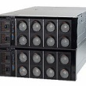
Lenovo Solution for SAP HANA with X6 适用场景：Datamart, BW, and Suite on HANA scenarios，单节点或双机HA/DR
256GB | 512GB | 768GB | 1TB | 1.5TB | 2TB* | 3TB* | 4TB* (available under relaxed HW requirements) | 6TB* (available under relaxed HW requirements)
x3950 X6 | x3950 X6 | x3950 X6 | x3950 X6 | x3950 X6 | x3950 X6 | x3950 X6 | x3950 X6 | x3950 X6
6241-AC4 | 6241-AC4 | 6241-AC4 | 6241-AC4 | 6241-AC4 | 6241-AC4 | 6241-AC4 | 6241-AC4 | 6241-AC4
AC44H256S | AC44H512S | AC44H768S | AC44H1024S | AC44H1536S | AC44H2048S | AC44H3072S | AC44H4096S | AC44H6144S
Standalone | Standalone | Standalone | Standalone | Standalone | Standalone | Standalone | Standalone | Standalone
4x E7-8880v3 | 4x E7-8880v3 | 4x E7-8880v3 | 4x E7-8880v3 | 4x E7-8880v3 | 4x E7-8880v3 | 4x E7-8880v3 | 4x E7-8880v3 | 4x E7-8880v3
256GB DDR3/4 (32x 8GB) | 512GB DDR3/4 (32x 16GB or 64x 8GB) | 768GB DDR3/4 (96x 8GB) | 1 TB DDR3/4 (32x 32GB or 64x 16GB) | 1.5 TB DDR3/4 (96x 16GB) | 2 TB DDR3/4 (32x 64GB or 64x 32GB) | 3 TB DDR3/4 (96x 32GB) | 4 TB DDR3/4 (64x 64GB) | 6 TB DDR3/4 (96x 64GB)
6x1.2TB HDD 2x400GB SSD | 6x1.2TB HDD 2x400GB SSD | 12x1.2TB HDD 4x400GB SSD | 12x1.2TB HDD 4x400GB SSD | 12x1.2TB HDD 4x400GB SSD | 12x1.2TB HDD 4x400GB SSD | 21x1.2TB HDD 6x400GB SSD | 21x1.2TB HDD 6x400GB SSD | 30x1.2TB HDD 6x400GB SSD
1x M5210 | 1x M5210 | 2x M5210 | 2x M5210 | 2x M5210 | 2x M5210 | 2x M5210 1x M5225 | 2x M5210 1x M5225 | 2x M5210 1x M5225
3.6 TB RAID5 data/log | 3.6 TB RAID5 data/log | 9.6 TB RAID5 data/log | 9.6 TB RAID5 data/log | 9.6 TB RAID5 data/log | 9.6 TB RAID5 data/log | 19.2TB RAID5 data/log | 19.2 TB RAID5 data/log | 28.8 TB RAID5 data/log
4x 10GbE 8x 1GigE | 4x 10GbE 8x 1GigE | 4x 10GbE 8x 1GigE | 4x 10GbE 8x 1GigE | 4x 10GbE 8x 1GigE | 4x 10GbE 8x 1GigE | 4x 10GbE 8x 1GigE | 4x 10GbE 8x 1GigE | 4x 10GbE 8x 1GigE
Upgrade Options: 256 → 512 | Upgrade Options: 512 → 1T 512 → 768 4S → 8S | Upgrade Options: - | Upgrade Options: 1T → 2T 1T → 1.5T 4S → 8S | Upgrade Options: - | Upgrade Options: 2T → 4T 2T → 3T 4S → 8S | Upgrade Options: - | Upgrade Options: 4T → 6T 4S → 8S | Upgrade Options: -
注：必须同时包含初始安装服务
* For Suite on HANA only, not for Datamart and BW

Slide 8
Lenovo Solution for SAP HANA with X6 适用场景：Datamart, BW, and Suite on HANA scenarios，单节点或双机HA/DR
512GB | 1TB | 1.5TB | 2TB | 3TB | 4TB* | 6TB* | 8TB* (available under relaxed HW requirements) | 12TB* (available under relaxed HW requirements)
x3950 X6 | x3950 X6 | x3950 X6 | x3950 X6 | x3950 X6 | x3950 X6 | x3950 X6 | x3950 X6 | x3950 X6
6241-AC4 | 6241-AC4 | 6241-AC4 | 6241-AC4 | 6241-AC4 | 6241-AC4 | 6241-AC4 | 6241-AC4 | 6241-AC4
AC48H512S | AC48H1024S | AC48H1536S | AC48H2048S | AC48H3072S | AC48H4096S | AC48H6144S | AC48H8192S | AC48H12288S
Standalone | Standalone | Standalone | Standalone | Standalone | Standalone | Standalone | Standalone | Standalone
8x E7-8880v3 | 8x E7-8880v3 | 8x E7-8880v3 | 8x E7-8880v3 | 8x E7-8880v3 | 8x E7-8880v3 | 8x E7-8880v3 | 8x E7-8880v3 | 8x E7-8880v3
512GB DDR3/4 (64x 8GB) | 1 TB DDR3/4 (64x 16GB or 128x 8GB) | 1.5 TB DDR3/4 (192x 8GB) | 2 TB DDR3/4 (64x 32GB or 128x 16GB) | 3 TB DDR3/4 (192x 16GB) | 4 TB DDR3/4 (64x 64GB or 128x 32GB) | 6 TB DDR3/4 (192x 32GB) | 8 TB DDR3/4 (128x 64GB) | 12 TB DDR3/4 (192x 64GB)
6x1.2TB HDD 2x400GB SSD | 12x1.2TB HDD 4x400GB SSD | 12x1.2TB HDD 4x400GB SSD | 12x1.2TB HDD 4x400GB SSD | 21x1.2TB HDD 6x400GB SSD | 21x1.2TB HDD 6x400GB SSD | 30x1.2TB HDD 6x400GB SSD | 39x1.2TB HDD 8x400GB SSD | 57x1.2TB HDD 10x400GB SSD
1x M5210 | 2x M5210 | 2x M5210 | 2x M5210 | 2x M5210 1x M5225 | 2x M5210 1x M5225 | 2x M5210 1x M5225 | 2x M5210 2x M5225 | 2x M5210 3x M5225
3.6TB RAID5 data/log | 9.6TB RAID5 data/log | 9.6TB RAID5 data/log | 9.6TB RAID5 data/log | 19.2TB RAID5 data/log | 19.2TB RAID5 data/log | 28.8TB RAID5 data/log | 38.4TB RAID5 data/log | 57.6TB RAID5 data/log
4x 10GbE 8x 1GigE | 4x 10GbE 8x 1GigE | 4x 10GbE 8x 1GigE | 4x 10GbE 8x 1GigE | 4x 10GbE 8x 1GigE | 4x 10GbE 8x 1GigE | 4x 10GbE 8x 1GigE | 4x 10GbE 8x 1GigE | 4x 10GbE 8x 1GigE
Upgrade Options: 512 → 1T | Upgrade Options: 1T → 2T 1T → 1.5T | Upgrade Options: - | Upgrade Options: 2T → 4T 2T → 3T | Upgrade Options: - | Upgrade Options: 4T → 8T 4T → 6T | Upgrade Options: - | Upgrade Options: 8T → 12T | Upgrade Options: -
注：必须同时包含初始安装服务
* For Suite on HANA only, not for Datamart and BW

Slide 9
Lenovo Solution for SAP HANA with X6 适用场景：BW and Datamart集群HA
512GB | 1TB | 1.5TB | 2TB (available under relaxed HW requirements) | 3TB (available under relaxed HW requirements) | 4TB (available under relaxed HW requirements) | 6TB (available under relaxed HW requirements)
x3850 X6 | x3850 X6 | x3850 X6 | x3850 X6 | x3850 X6 | x3850 X6 | x3850 X6
6241-AC3 | 6241-AC3 | 6241-AC3 | 6241-AC3 | 6241-AC3 | 6241-AC3 | 6241-AC3
AC34H512C | AC34H1024C | AC34H1536C | AC34H2048C | AC34H3072C | AC34H4096C | AC34H6144C
Scaleout up to 94 nodes | Scaleout up to 94 nodes | Scaleout up to 94 nodes | Scaleout | Scaleout | Scaleout | Scaleout
4x E7-8880v3 | 4x E7-8880v3 | 4x E7-8880v3 | 4x E7-8880v3 | 4x E7-8880v3 | 4x E7-8880v3 | 4x E7-8880v3
512GB DDR3/4 (32x 16GB or 64x 8GB) | 1TB DDR3/4 (32x 32GB or 64x 16GB) | 1.5TB DDR3/4 (96x 16GB) | 2TB DDR3/4 (32x 64GB or 64x 32GB) | 3TB DDR3/4 (96x 32GB) | 4TB DDR3/4 (64x 64GB) | 6TB DDR3/4 (96x 64GB)
15x1.2TB HDD 4x400GB SSD | 15x1.2TB HDD 4x400GB SSD | 15x1.2TB HDD 4x400GB SSD | 24x1.2TB HDD 4x400GB SSD | 33x1.2TB HDD 6x400GB SSD | 42x1.2TB HDD 6x400GB SSD | 51x1.2TB HDD 8x400GB SSD
1x M5210 1x M5225 | 1x M5210 1x M5225 | 1x M5210 1x M5225 | 1x M5210 1x M5225 | 1x M5210 2x M5225 | 1x M5210 2x M5225 | 1x M5210 3x M5225
13.2 TB RAID5 data/log | 13.2 TB RAID5 data/log | 13.2 TB RAID5 data/log | 22.8 TB RAID5 data/log | 32.4 TB RAID5 data/log | 42 TB RAID5 data/log | 51.6 TB RAID5 data/log
4x 10GbE 4x 1GigE | 4x 10GbE 4x 1GigE | 4x 10GbE 4x 1GigE | 4x 10GbE 4x 1GigE | 4x 10GbE 4x 1GigE | 4x 10GbE 4x 1GigE | 4x 10GbE 4x 1GigE
Upgrade Options: 512 → 1T 512 → 768 | Upgrade Options: 1T → 2T 1T → 1.5T | Upgrade Options: - | Upgrade Options: 2T → 4T 2T → 3T | Upgrade Options: - | Upgrade Options: 4T → 6T | Upgrade Options: -
注：必须同时包含初始安装服务
* For Suite on HANA only, not for Datamart and BW

Slide 10
Lenovo Solution for SAP HANA with X6 适用场景：BW and Datamart集群HA
4 processors |  |  | 8 processors
512GB | 1TB | 1.5TB | 512GB | 1TB | 2TB | 3TB | 4TB (available under relaxed HW requirements) | 6TB* (restricted ramp-up SAPnote 1950470) | 12TB (available under relaxed HW requirements)
x3950 X6 | x3950 X6 | x3950 X6 | x3950 X6 | x3950 X6 | x3950 X6 | x3950 X6 | x3950 X6 | x3950 X6 | x3950 X6
6241-AC4 | 6241-AC4 | 6241-AC4 | 6241-AC4 | 6241-AC4 | 6241-AC4 | 6241-AC4 | 6241-AC4 | 6241-AC4 | 6241-AC4
AC44H512C | AC44H1024C | AC44H1536C | AC48H512C | AC48H1024C | AC48H2048C | AC48H3072C | AC48H4096C | AC48H6144C | AC48H12288S
Scaleout to 94 nodes | Scaleout to 94 nodes | Scaleout to 94 nodes | Scaleout to 94 nodes | Scaleout to 94 nodes | Scaleout to 94 nodes | Scaleout to 94 nodes | Scaleout | Scaleout to 4+1 nodes | Scaleout
4x E7-8880v3 | 4x E7-8880v3 | 4x E7-8880v3 | 8x E7-8880v3 | 8x E7-8880v3 | 8x E7-8880v3 | 8x E7-8880v3 | 8x E7-8880v3 | 8x E7-8880v3 | 8x E7-8880v3
512GB DDR3/4 (32x 16GB or 64x 8GB) | 1 TB DDR3/4 (32x 32GB or 64x 16GB) | 1 TB DDR3/4 (96x 16GB) | 512GB DDR3/4 (64x 8GB) | 1 TB DDR3/4 (64x 16GB or 128x 8GB) | 2 TB DDR3/4 (64x 32GB or 128x 16GB) | 3 TB DDR3/4 (192x 16GB) | 4 TB DDR3/4 (64x 64GB or 128x 32GB) | 6 TB DDR3/4 (192x 32GB) | 12 TB DDR3/4 (192x 64GB)
12x1.2TB HDD 4x400GB SSD | 12x1.2TB HDD 4x400GB SSD | 12x1.2TB HDD 4x400GB SSD | 12x1.2TB HDD 4x400GB SSD | 12x1.2TB HDD 4x400GB SSD | 21x1.2TB HDD 6x400GB SSD | 30x1.2TB HDD 6x400GB SSD | 39x1.2TB HDD 8x400GB SSD | 57x1.2TB HDD 10x400GB SSD | 102x1.2TB HDD 14x400GB SSD
2x M5210 | 2x M5210 | 2x M5210 | 2x M5210 | 2x M5210 | 2x M5210 1x M5225 | 2x M5210 1x M5225 | 2x M5210 2x M5225 | 2x M5210 3x M5225 | 2x M5210 5x M5225
9.6TB RAID5 data/log | 9.6TB RAID5 data/log | 9.6TB RAID5 data/log | 9.6TB RAID5 data/log | 9.6TB RAID5 data/log | 19.2TB RAID5 data/log | 28.8TB RAID5 data/log | 38.4TB RAID5 data/log | 57.6TB RAID5 data/log | 105.6TB RAID5 data/log
4x 10GbE 8x 1GigE | 4x 10GbE 8x 1GigE | 4x 10GbE 8x 1GigE | 4x 10GbE 8x 1GigE | 4x 10GbE 8x 1GigE | 4x 10GbE 8x 1GigE | 4x 10GbE 8x 1GigE | 4x 10GbE 8x 1GigE | 4x 10GbE 8x 1GigE | 4x 10GbE 8x 1GigE
Upgrade Options: 512 → 1T | Upgrade Options: 1T → 1.5T 4S → 8S | Upgrade Options: 4S → 8S | Upgrade Options: 512 → 2T | Upgrade Options: 1T → 2T*¹ | Upgrade Options: 2T → 6T 2T → 3T | Upgrade Options: - | Upgrade Options: 4T → 8T 4T → 6T | Upgrade Options: - | Upgrade Options: -
注：必须同时包含初始安装服务
* For Suite on HANA only, not for Datamart and BW

Slide 11
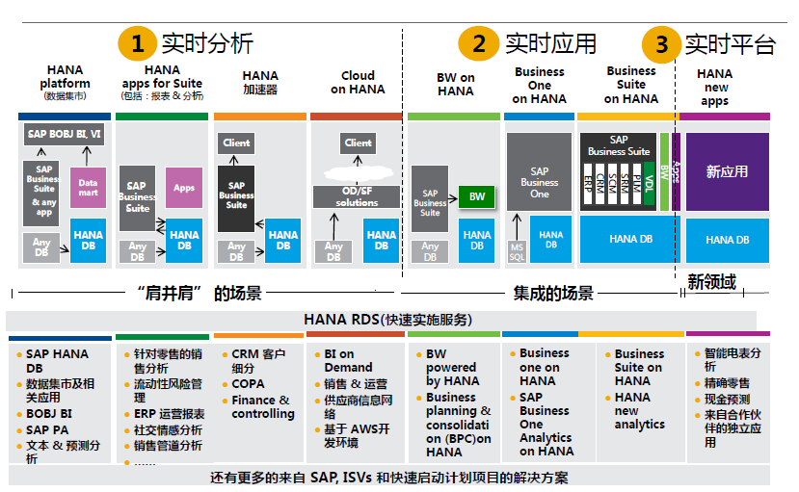
联想面向SAP HANA的一体机服务产品
1.HANA基础架构搭建解决方案
架构层/平台层/应用层：设计部署
2.BW on HANA迁移解决方案
架构层/平台层：迁移可行性分析/迁移方案制定/POC/优化/升级
应用层：设计部署
3.HANA系统的运维与调优
架构层/平台层/应用层：排错/优化/巡检/升级
系统逻辑分层：
架构层级 | 部件
应用层 | 以BW相关服务业务为核心
平台层 | RUNTIME(NetWeaver)
 | HANA
架构层 | GPFS
 | OS(SUSE)
 | Hardware

Slide 12
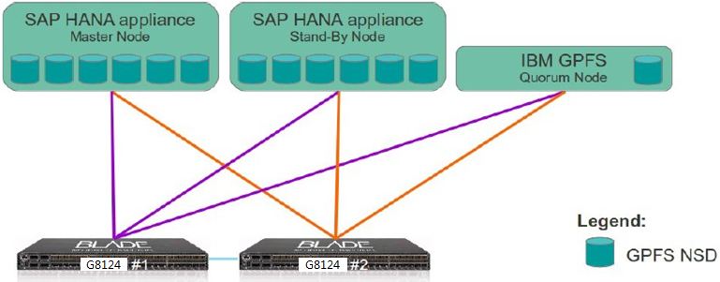
高可用性 - 利用GPFS，一个数据库自动故障切换
单节点高可用性解决方案：
一个HANA主节点生产，一个HANA热备节点。另外需要一个GPFS仲裁节点x3550M5，此节点不参与HANA数据计算，但用于GPFS集群。

Slide 13
灾备 - 利用SAP HANA System Replication (同步/异步)，两个数据库人工故障切换
HANA single node 1
x3850X6/x3950X6
HANA single node 2
x3850X6/x3950X6
SAP HANA System Replication
基于SUSE HA的自动切换技术，没有SAP的认证
https://www.suse.com/promo/saphana-replication.html
http://scn.sap.com/community/hana-in-memory/blog/2014/04/04/fail-safe-operation-of-sap-hana-suse-
extends-its-high-availability-solution
SAP HANA内核功能，需要SAP Service实施，网络根据客户需求而定。一般每天4.3TB的持久层数据，大约需要0.5Gbit/s的传输网络

Slide 14
SAP HANA – 向外扩展及高可用性
node01
node02
node03
node04
SAP HANA DB
DB partition 1
DB partition 2
DB partition 3
- SAP HANA DB
Worker node
- SAP HANA DB
Worker node
- SAP HANA DB
Worker node
- SAP HANA DB
Standby node
- Index server
- Statistic server
- SAP HANA studio
- Index server
- Statistic server
- Index server
- Statistic server
- Index server
- Statistic server
Shared file system - GPFS
local storage
local storage
local storage
local storage
First replica
data01 + log01
data02 + log02
data03 + log03
Second replica

Slide 15
SAP HANA – 向外扩展及高可用性
node01
node02
node03
node04
SAP HANA DB
DB partition 1
DB partition 2
DB partition 3
- SAP HANA DB
Worker node
- SAP HANA DB
Worker node
- SAP HANA DB
Defunct node
- SAP HANA DB
Worker node
- Index server
- Statistic server
- SAP HANA studio
- Index server
- Statistic server
- Index server
- Statistic server
- Index server
- Statistic server
Shared file system - GPFS
local storage
local storage
local storage
local storage
First replica
data01 + log01
data02 + log02
data03 + log03
Second replica

Slide 16
SAP HANA – 向外扩展及高可用性
node01
node02
node03
node04
SAP HANA DB
DB partition 1
DB partition 2
DB partition 3
- SAP HANA DB
Worker node
- SAP HANA DB
Worker node
- SAP HANA DB
Standby node
- SAP HANA DB
Worker node
- Index server
- Statistic server
- SAP HANA studio
- Index server
- Statistic server
- Index server
- Statistic server
- Index server
- Statistic server
Shared file system - GPFS
local storage
local storage
local storage
local storage
First replica
data01 + log01
data02 + log02
data03 + log03
Second replica

Slide 17
Lenovo面向SAP HANA™解决方案售后支持
PMR
Process
Customer
SAP HANA
Lssue
Integrated Lenovo & SAP
Support Team
for SAP HANA
BC-OP-LNX-Lenovo
OSS
Process
Lenovo HANA Operations Guide (Lenovo HANA维护手册客户版，可从SAP Note 1650046中获得)

Slide 18
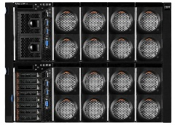
简单、灵活、高扩展性的解决方案
向外扩展：集群可以扩展到94个节点；集群单节点容量最大8S3T，且为同一机型
SAP HANA扩展解决方案摘要 简单、无缝、可扩展性
…
简单
IBM GPFS消除了对SAN的需求
无需SAN管理
可通过添加节点轻松扩展
简单的订购流程
灵活
IBM GPFS提供高可用性
集成包装可降低风险并且加快部署速度
简单的基础架构能够降低长期维护需求
可扩展
IBM GPFS允许扩展到94个节点
满足大规模数据库需求
通过SAP验证
最多的成功案例和实施经验
对于集群来说具有同样的横向和纵向的扩展能力
向外扩展
向外扩展
向上扩展
向上扩展：针对Suite on HANA机型，单节点可以
扩展到8S6T，且是同一机型

Slide 19
中国成功案例
某证券
某汽车制造
某部委研究中心
某时装
某电视推销
某钢铁制造
某保险
某纺织
某煤企
某通信
某汽车销售
某面企
某眼镜
某啤酒
某超市
某化妆品
某鸭脖
某建材
某体育用品
某食品制造
某设备制造
某鞋业
某化工
某能源
某重工制造
某厨具
某电力
某日化
某药业
某制造企业
某出版社
某酒业
某金属制造
某环境
某电源
某丝绸
某卫生用品
某政府部门
“伴随业务发展，x3850/x3950可以按需扩展CPU和内存；同时依托GPFS文件系统可以进行集群扩展。”
“为企业提供一个灵活、开放的信息管理平台，方便随时了解和监控下属企业的运营情况，能实时查阅下属公司财务、生产、销售、人事、成本、收益等方面的信息。”
“企业对未来发展的预期非常好，所以，搭建SAP HANA系统平台，不仅要满足现在的需求还要重点考虑未来扩展的功能。Lenovo有完整的产品线，未来我们可以很灵活的进行升级、扩容，非常方便。”
示例

