Slide 1
Storage Center 6.x 软件概览
扩展智能化数据存放的边界

Slide 2
内容列表
部分 | 内容 | 页面编号
产品战略概览 | 市场增长 产品发布流程 智能化的数据存放 | 3 – 9
SCOS 6.7 (新!) | 支持SC9000 支持12GB SAS 盘柜 全新的 SC8000/SC4020/SCv2000 功能 Live Volume ，支持Auto Failover – 仅限于SC8000/SC4020 强化的压缩技术– 仅限于SC8000/SC4020 Application protection Manager for Oracle Thin Import（精简导入） | 10 – 19
SCOS 6.6 | 支持SCv2000 全新的 SC4020 功能 增强的功能 (可支持192个硬盘) 支持SC280 Compression（压缩） Live volume 支持多协议（Multi-Protocol ） | 20 – 22
SCOS 6.5.20 | 单层级闪存(支持 $25K AFA) | 23 – 26
SCOS 6.x | Fluid Cache for SAN 数据块级的压缩 Live Volume/Replication功能的增强 Data-at-Rest Encryption（静态数据加密） Multi-VLAN Tagging | 27 – 33
技术细节 | 更多的背景信息 | 34 – 43

Slide 3
490%
缺口
IDC针对下一个十年全球数据增长的 预测
Gartner针对2014年全球IT支出所做的 估算
3%
Notes:
This is the fundamental customer problem. Data growth is skyrocketing, but IT spend is remaining flat. This is the centerpiece problem to every data management conversation you will have. Today you’re going to learn how we solve this problem with a strategy centered on putting the right data in the right place at the right time at the right cost to position Dell where we are advantaged, facilitate a workloads discussion with your customer, and have an economics conversation that addresses this main challenge.

Slide 4
戴尔的持续创新战略
把高端功能延伸到中端产品
创新
集成
1
2
扩展
3
用中端产品颠覆企业级产品的经济性
Notes:
[Highlight Dell’s “changing the economics of enterprise storage” message. Draw attention to Dell’s continuing cycle of
Enterprise-class technology innovation, followed by
“Democratization” or extension of that technology to more customers at more affordable price points.
Focus primarily on the Innovation and Extension. Use slide to set up point that SC6.x enhancements are true enterprise advantages engineered to be affordable and practical for business of all sizes.]

Slide 5
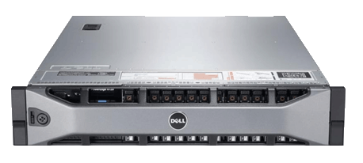
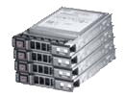
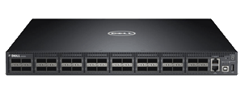
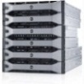
让数据离计算更近…提升性能和敏捷度
Dell Cache Contributor Servers
（缓存提供服务器）*
Cache Client Servers
（缓存客户端服务器）**
戴尔服务器*
R620, R720, R820, R920 M620, M820
缓存池
戴尔网络**
S4810, S6000, MXL
专用缓存网络
戴尔存储
Dell Compellent SC8000
存储网络 (FC 或 iSCSI)
71%
99%
超过 5 百万的IOPS!
每个用户降低71%的成本
数据响应速度提升99%
*可以与非戴尔服务器协同工作 ** 包括对Nexus 5548UP的支持
*构建缓存池需要至少3个适合的戴尔服务器。
**缓存客户端服务器可以混搭戴尔和非戴尔服务器，非戴尔服务器需要运行受支持的操作系统和拥有适用的PCIe插槽。
Notes:
Server-side caching solution that creates a large-scale, low latency cache by pooling DELL Express Flash SSD’s both within a server and between servers across a network
The cache pool is mounted over a Storage Center SAN and will accelerate writes, read-after-writes and re-reads.
Connecting the servers using a high-speed fabric such as 10/40Gigabit Ethernet or Infiniband allows this cache pool to be accessible several orders of magnitude faster than traditional storage.
The size of the cache pool is limited only by the total amount of SSD capacity in the server or cluster
The cache pool is highly available and resilient to failures
Works with legacy servers (as “cache clients”)
Dell Fluid Cache for SAN can dramatically reduce the cost per user on a 3 node OLTP cluster running on an Oracle® database by 71%.
*Based on Dell Lab testing of a 3 node OLTP cluster on an Oracle® database with Dell Fluid Cache for SAN vs. the same configuration without Dell Fluid Cache for SAN, where the configuration with Dell Fluid Cache for SAN resulted in 1900 concurrent users at one second and costs $360,191 USD, or $189.57 USD per user, at the one second measurement, and the configuration without Dell Fluid Cache for SAN resulted in 500 concurrent users at one second and costs $331,696 USD, or $663.39 USD per user, at the one second measurement. List prices dated March 2014.

Slide 6
Storage Center 6.x: 扩展智能化数据存放的边界
戴尔现在拥有Data Progression（数据调度）的关键优势，可以各个层面上优化企业级的存储
服务器
Fluid Cache
智能化
的数据存储
高性能的存储层
业界领先的
闪存优化技术
“冷”数据
智能化的数据压缩
业务持续性
保障存储安全
Notes:
Storage Center 6.x builds on key performance and auto-tiering advancements of previous Storage Center releases to extend the benefits of Dell’s “intelligent data placement” technology to more customers and more solution categories. Each enhancement described in this presentation increases the scope and range of the overall Storage Center solution, taking Dell’s proven “right data in the right place, at the right time, for the right cost” technology approach to new levels. New and existing customers will benefit immediately from the increased performance, efficiency and cost-savings value of SC 6.x, the most full-featured Storage Center release to date.
With SC 6.x,
Hot data moves closer to servers to increase the speed of applications
Cold storage is compressed to become even more cost-effective
Data is made more controllable, more highly available, and more secure.
Let’s look at an overview of 6.x enhancements…

Slide 7
SCOS 的发布流程
Fluid Cache, SEDs, SLV
性能
LV-AFO
APM-Oracle
ASR
64位 OS
SC6.0
SC6.1
SC6.2
SC6.3
SC6.4
SC6.5
SC6.6
SC6.7
SC200/220/280 盘柜
闪存优化/密度
SCv2000 控制器
SC100/120/180 盘柜
SC9000 控制器
SC400/420 盘柜
SC8000
Notes:
[History of SC releases. Next slide summarizes the strategy/theme of SC 6.x]

Slide 8
Storage Center 发布计划
SCOS 6.0-6.3
SCOS 6.4
SCOS 6.5
SCOS 6.6
SCOS 6.7
SC8000 发布
SC200/SC220 扩展
64位 OS
高性能多核处理器
SC280 发布
闪存优化型配置
全新的读取密集型硬盘
SC4020 发布
SC8000 升级
Fluid Cache for SAN
静态数据加密
数据压缩
同步Live Volume
容量提升
安全和带宽管理
单点登录
Multi-VLAN Tagging
单一的1级读取密集型固态硬盘
强化Data Progression
SCv2000 发布
SC100/SC120/ SC180 发布
iSCSI & FC 协议支持
SC4020 升级
可支持192个硬盘
支持SC280
支持混合的iSCSI 和 FC协
压缩
SC9000 发布
SC400/SC420 扩展
SC8000/SC4020 升级
带有自动故障迁移（Auto-Failover）的Live Volume
强化的压缩
从PS系列上的精简导入
针对Oracle的应用保护管理器（Application Protection Manager for Oracle）

Slide 9
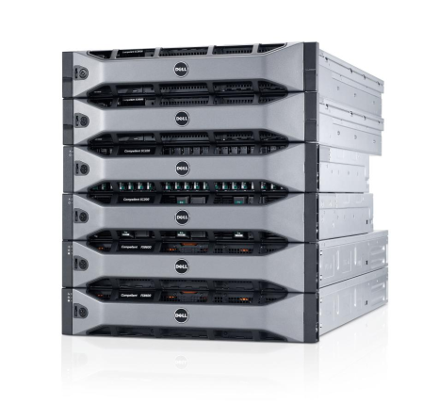
Storage Center 6.x 的增强特性
VLAN 1
Fluid Cache
VLAN 2
VLAN 3
VLAN 4
强化的可用性
应用加速
针对服务提供商的优化
更高的容量
1级
闪存
2级
闪存
高效和低成本
节省的资金
静态数据安全
3级
硬盘
Notes:
[Briefly highlight features as slide builds – detail comes later.]
Here are the major enhancement categories the comprise the SC 6.5 release – we’ll look at the details later in presentation.
100% greater capacity – Storage Center systems are now tested and supported up to 2PB addressable capacity – a phenomenal amount of data for one array!
Demonstrates Storage Center’s suitability for very large enterprise datacenters
Enabled by ongoing improvements in the efficiencies of our storage algorithms, as well as broadening test coverage, due to increasing high end demand from our enterprise customers.
Efficiency and cost reduction – In addition to increasing overall capacity, we’re also making that capacity more efficient then ever before with the addition of new block-level compression
[NOTE: Make sure viewer understands 100% capacity increase does NOT come from Compression – i.e., Compression is a separate benefit offering even more capacity and cost savings.]
Enhanced availability – …we’ve added a number of enhancements that provide greater coverage for data backup and protection, enabling new levels of business continuity and more robust DR plans.
Application acceleration – …we’re moving hot data closer to the server with server-side cache clusters, making business-critical applications run faster
Service provider optimization – …we’re enabling new strategies for service providers and large multi-department organizations with new capabilities for interacting with virtualized networks.
Data-at-Rest Security – …and we’re enabling greater degrees of security and compliance with Data-at-Rest encryption technology
Let’s look at each of these features in greater detail.

Slide 10
SCOS 6.7 升级

Slide 11
要点
策略
提供自动故障转移功能，以提高业务连续性和改进灾难恢复
提供强化的压缩功能，以提高数据削减率和数据效率
存储集成了Application Protection Manager for Oracle 和 IBM-AIX
提供从EQL PS到SC的精简导出功能，提高戴尔存储产品线的一致性
SCOS 6.7特性列表
支持SC9000和12Gb SAS盘柜
具备自动故障转移功能的Live Volume
数据精简：第二阶段压缩
支持固态硬盘和自加密硬盘
应用程序/第三方集成
Application Protection Manager for Oracle
IBM-AIX
Enterprise Manager特性列表
提供从EQL PS到SC的精简导出功能

Slide 12
Live Volume意味着数据的流动 它看起来像什么?
单存储主机映射数据中心内的两个阵列
带有集群文件系统的多个存储主机映射数据中心内或数据中心之间的阵列
MPIO
MPIO
Live Volume
MPIO
MPIO
Live Volume
Live Volume
充足的带宽
低延迟
Live Volume
Live Volume
充足的带宽
低延迟
Live Volume

Slide 13
SCOS 6.7支持带有自动故障转移功能的Live Volume Synchronous Live Volume中的自动故障转移支持持续的IO读写
专为避免单点故障
而设计
3 虚拟机被迁移到还原服务器上
4 其它的应用可能被启动
1 某个服务器、网络或存储系统出现中断。
Live Volume
主
次
Synchronous Replication
（同步复制）
自动的
故障转移
Enterprise Manager
2 Enterprise Manager 启动自动的故障转移
5 Enterprise Manager 随后能够将系统还原到初始的主系统上

Slide 14
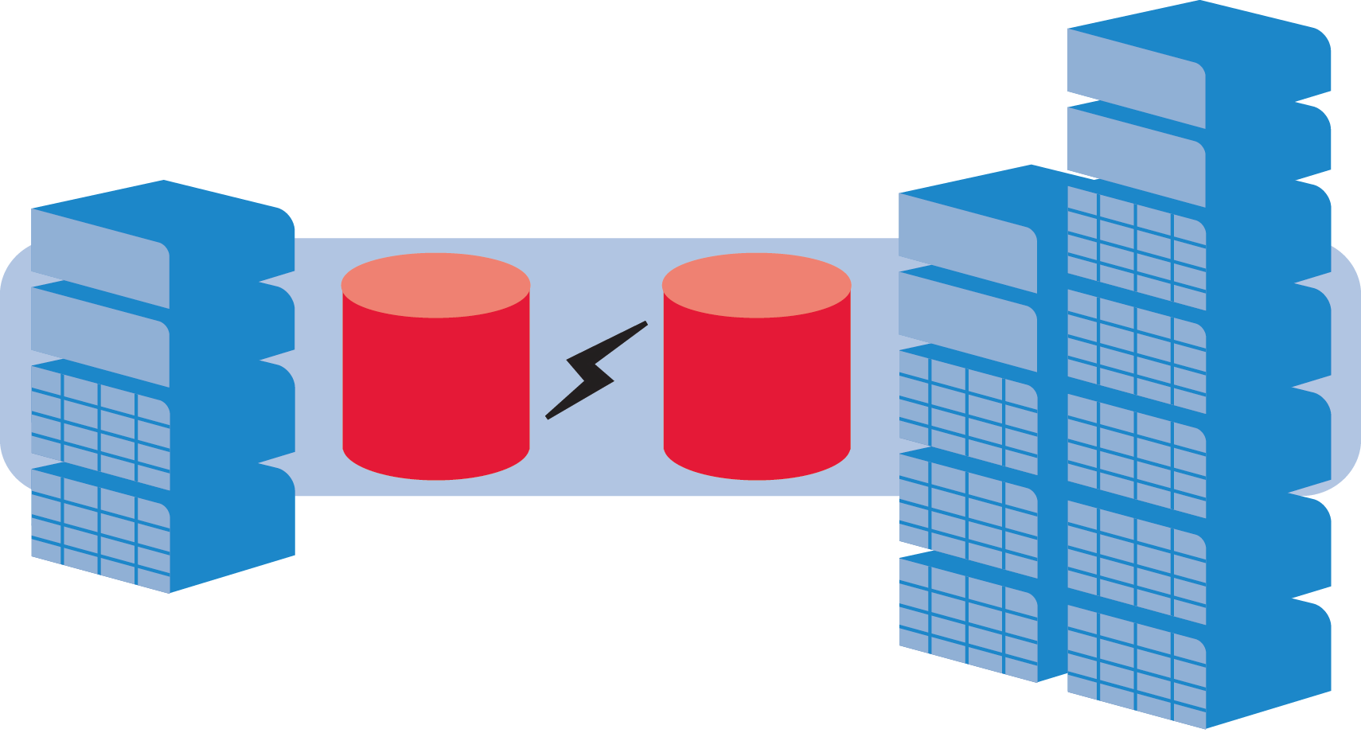
具备自动故障转移功能的Live Volume
使用同步复制功能在两台阵列之间迁移卷
卷自动故障转移功能使读写IO保持连续可用性，可满足最苛刻的恢复时间目标要求
vMSC认证
仅限于VMware vSphere
适用情境
主存储故障
次存储故障
网络分区故障
后台故障
X
Enterprise Manager
Live Volume
Live Volume
具备自动故障转移功能的同步Live Volume

Slide 15
增强的数据压缩技术
应用到更多配置上
能够进一步节省容量
全闪存阵列
全新的增强型压缩技术最多能够节省93%的容量
T1
单级全闪存阵列（AFA）
写入密集型固态硬盘
T2
应用 | 最多可节省…
VMware | 52.47%
Microsoft SQL | 93.65%
Microsoft Hyper-V | 39.85%
ESXi Virtual Machines | 40.93%
读取密集型固态硬盘
混合式阵列
传统硬盘阵列
写入密集型固态硬盘
T1
T1
读取密集型固态硬盘
传统硬盘
T2
T2
T3
传统硬盘
传统硬盘
作用于最低层级的存储(固态硬盘或传统硬盘)
易于“开启/关闭”，可在卷上做出灵活选择

Slide 16
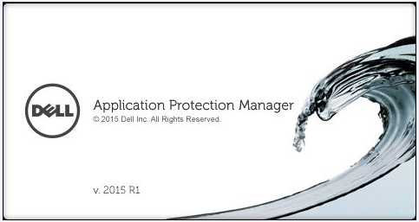
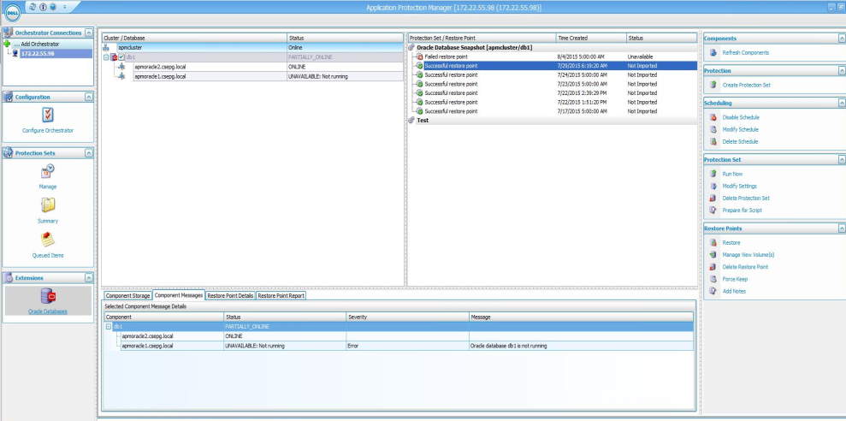
Application Protection Manager 概述
Oracle管理员可使用APM for Oracle来保护和恢复数据，而无需存储管理员或服务器管理员的帮助
APM包含在Enterprise Manager 2015R2之中
APM Windows Client和Linux代理程序可从Enterprise Manager Data Collector网站下载
Linux代理程序被安装在每一台Oracle服务器上以获得保护，并且必须在EM/APM服务器上注册
Storage Center上需要具备APM许可

Slide 17
Dell Storage Software Suite for AIX 概述
Dell Storage Software Suite for AIX
启用Dell Storage Center 虚拟接口模式功能，可提供更好的路径提取和保护，并显著降低管理开销
允许SC所连接的AIX主机使用MPIO技术来提高可用性和强化自动路径故障转移保护。
支持从AIX 6.1到7.1版本
与IBM AIX功能协同工作，例如动态追踪和多路径I/O (MPIO)
IBM已将Dell Storage Software Suite for AIX指定为为Power系统软件验证准备就绪项目的“受到VIOS认可的”类别

Slide 18
各个平台的许可证特性摘要
特性 | SCv2000 | SC4020 | S-40 | SC8000 | SC9000 | 对许可证的要求
支持Fluid Cache | 不提供 | 不提供 | 不提供 | ✓ | ✓ | 仅需要服务器许可证
可寻址的容量 | 500TB | 700TB | 2PB | 2PB | 2PB | 不收费
Data Progression | Raid tiering | ✓ | ✓ | ✓ | ✓ | Data progression 许可证
Multi-VLAN Tagging | 不提供 | ✓ | ✓ | ✓ | ✓ | 不收费
LDP/Data Instant Replay | LDP | ✓ | ✓ | ✓ | ✓ | 不收费
在一级存储中支持读取密集型固态硬盘 | ✓ | ✓ | ✓ | ✓ | ✓ | 不收费
Replication（复制） | Async | ✓ | ✓ | ✓ | ✓ | Remote Instant Replay
Chargeback | 不提供 | ✓ | ✓ | ✓ | ✓ | Chargeback许可证
Replay Manager/APM | ✓ | ✓ | ✓ | ✓ | ✓ | Replay Manager许可证
FastTrack | 不提供 | ✓ | ✓ | ✓ | ✓ | FastTrack许可证
Compression（压缩） | 不提供 | ✓ | 不提供 | ✓ | ✓ | 不收费
Live Volume | 不提供 | ✓ | ✓ | ✓ | ✓ | Live Volume 许可证
自加密硬盘(SEDs) | 不提供 | 不提供 | ✓ | ✓ | ✓ | Encryption 许可证(每个阵列一个)。硬盘需要额外收费

Slide 19
SC6.6 升级
19

Slide 20
介绍- SCv2000
提供SC系列通用的管理功能，并打包提供可选的增值SC系列软件特性
快照
异步复制到其他SCv2000
Replay Manager
将软件iSCSI添加到任何控制器以便于支持多种协议
适用于VMWare和Microsoft控制台的管理插件
动态RAID分级(单层优化)
连续快照
可由客户安装
可配置性高

Slide 21
SC4020的新功能
当前的SC4020客户可免费、无中断地将固件升级到6.6版，从而启用以下新功能。
Live volume
在SC4020之间同步复制，在SC4020与其他SC系统之间异步复制SC8000.
更大的容量(现已支持192个硬盘)
将所支持的硬盘数量从120个增加到192个
数据压缩
压缩冷动的、不可访问的数据
SC4020多协议支持
在同一配置之中支持光纤通道和iSCSI
支持SC280扩展盘柜
SC4020支持后挂SC280扩展盘柜

Slide 22
SC6.5.20 升级
22

Slide 23
SC6.5.20有哪些新特性?
SC4020 和 SC8000 的客户（持有最新的Copilot协议）能够无中断地升级到SC6.5.20 固件，并无需付费。
读取密集型(RI) 的驱动器现在可用于1级存储
在之前，1级存储只能使用写入密集型的驱动器和传统的转轴驱动器。
SC4020 的最低配置从12个硬盘变成6个硬盘
SC8000的最低硬盘配置没有变化

Slide 24
SC6.5.20更新:有何影响？
SC系列现已支持4类阵列解决方案：
闪存优化型
入门级闪存
混合配置(客户的首选)
传统HDD硬盘阵列
多级闪存，提供写密集型和读密集型固态硬盘
单级闪存，提供经济的读密集型固态硬盘
混合使用固态硬盘和HDD硬盘并进行分级，充分发挥其各自的优势
用以满足大存储量需求的成本优化型解决方案
新!
业界价格最低的全闪存阵列！*
(6个)480GB读密集型固态硬盘，总容量达到2.8TB
相比HDD硬盘，显著提高了IOPs速度
灵活的扩展选项 – 可扩展为闪存优化型或混合式解决方案
零售价2.5万美元*
* $25,000是广告上的美国零售价格。上述比较基于的是2014年10月戴尔内部对超过1TB容量中端阵列的美国定价和典型美国折扣价的分析，其中包括支持成本。广告编号： A14000615

Slide 25
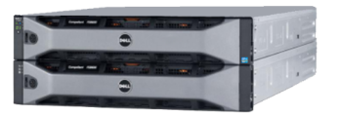
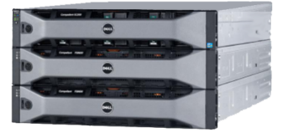
全新的$25K 全闪存阵列让您保持选择的自由
更快的写入！
Entry-Level Flash
Flash-Optimized
全闪存
从小规模起步
从这里起步可以扩展到任意规模
全闪存
增加更多的固态硬盘
*
混合式存储
增加传统硬盘的分级，以便节省更多的成本
* 尽管大多数用户能够从多级闪存式存储阵列中收益，但我们同样提供配备有写入密集型硬盘的混合式阵列或单级阵列
= 写入密集型固态硬盘
= 读取密集型固态硬盘
= 传统硬盘

Slide 26
SCOS 6.x 特性集

Slide 27
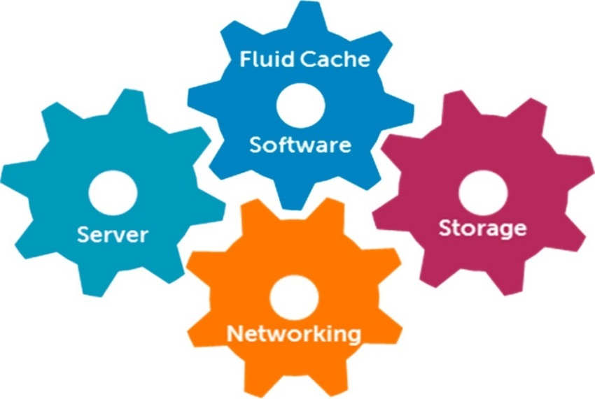
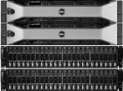
Fluid Cache for SAN
重新界定计算和存储的关系，为应用加速释放最大的潜力
服务器
存储
涡轮加速般的响应时间
扩展数据库和虚拟化的性能
提供有保证的完整性和一致性
网络
PowerEdge
Dell Networking
Dell Storage
SC9000
SC8000
戴尔网络
Notes:
SC 6.x integrates Storage Center support for Dell’s new Fluid Cache for SAN. This application acceleration solution uses Dell Express Flash PCIe SSDs and Dell Storage Center tiering technologies to move hot data closer to the server, minimizing storage latency, while safeguarding data with a shared cache pool that provides full redundancy in the case of server failure. Offering unprecedented I/O performance for applications such as OLTP and VDI, Fluid Cache and Storage Center solutions improve database response times by as much as 99%.

Slide 28
Fluid Cache带给企业的优势
统一的戴尔基础架构使您不必 在服务器性能和先进的SAN功能之间作出牺牲
自动化数据存放
全方位管理功能
企业SAN整合
从服务器到SAN，自动地对整个数据中心进行调节，以实现最高性能和最低成本
通过统一的界面控制高速缓存集群和Storage Center SAN，提供虚拟化的、灵活的解决方案
能察知高速缓存的快照
端到端可用性
使用已有的硬件
数据保护/复制，数据迁移、安全、压缩等
“以适合的成本，在适合的时间将适合的数据存放在适合的位置”
Notes:
When customers purchase Fluid Cache, they are getting access to a unified, mature infrastructure portfolio that works together to provide advantages no limited “point product” caching solution can offer. Fluid Cache provides world-class application acceleration plus…
Intelligent Data Placement – a comprehensive approach to data management that maximizes performance and reduces cost from the server all the way down to cold storage
Comprehensive Management – single Enterprise Manager interface controls Fluid Cache cluster AND Storage Center arrays.
Enterprise SAN Integration – no tradeoff between server performance and the world’s most advanced SAN platform. In addition to the management integration, Fluid Cache is also integrated with Storage Center’s new cache-aware Storage Center Snapshots, giving you complete data protection coverage and control from top to bottom of your storage infrastructure.

Slide 29
智能压缩成就高效的系统…更加高效
充分优化的数据存放
全新的块级压缩功能
使用更少的硬件存储更多的数据
利用知识产权技术Dell Ocarina
在SC8000、SC4020和 SC900之中受支持
由Data Progression（数据调度功能）控制
保持最高性能
智能化地瞄准适合压缩的数据–最高可占总存储量的80%
易于实施和控制
通过单击Enterprise Manager，可逐卷激活功能特性
快照可包含已压缩的数据
阵列类型 | 压缩级别
全闪存阵列(2个层级) | 第一级(闪存)
全闪存阵列(2个层级) | 第二级(闪存)
混合闪存阵列(2个层级) | 第三级(转轴硬盘)
混合闪存阵列(3个层级) | 第三级(转轴硬盘)
全转轴硬盘阵列(一个层级) | 第一级(转轴硬盘)
全转轴硬盘阵列(两个或3个层级) | 第三级(转轴硬盘)
首先运行数据压缩
不影响性能
第一级
第一级
第二级
第二级
数据压缩
$$ 省钱
第三级
第三级
最多可减少77%¹
的硬盘购买需求！
2 – SC4020 support requires 6.6 firmware update
Notes:
Storage Center’s new Compression feature lets customers store more data with less hardware, providing as much as a 77% reduction in required hard disk capacity and costs (up to 77% compression ratio) – with no negative impact to performance or user experience.
Transparent to applications and workloads, Storage Center Compression is fully integrated with and controlled by the system’s Data Progression algorithms. Standard Data Progression always runs first, optimizing block placement within the array according to real-time access and usage patterns. Compression follows as an automated post-process stage, applied only to new and old “historical” (inaccessible) data on Tier 3. Although this historical data can comprise up to 80% of the customer’s overall storage -- resulting in huge cost savings when compressed -- none of the actual user interactions with upper-level tiers are affected.
Storage Center customers using Compression can continue to take advantage of their existing enterprise-class SC features, many of which gain additional value when combined with the new capability. For instance, in Live Volume or Replication pairs, Compression may be configured independently for target and source arrays. This allows the arrays to be either fully mirrored, or compressed at different levels, depending on variable cost-saving policies and methods at different enterprise locations. In another example, Snapshots or View Volumes can each contain compressed data, further demonstrating Dell’s commitment to end-to-end integration and cost-savings.

Slide 30
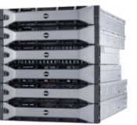
增强的数据保护和恢复
Live Volume +智能复制
同步Live Volume的新功能
保护您的全部数据–从任意时间点复原
为计划外停机做好准备
恢复点目标= 0
在SC8000、SC4020和SC9000之中受支持
从LV进行灾难恢复的新功能
可轻松切换到二级LV
无需重新装载LUN
恢复时间目标< 5分钟
复制到第三个地点的新功能
Live Volume代管复制
自动化、无中断的备份和恢复
同步Live Volume
主存储
LV保持100%的 一致性
次存储
无需配置服务器 即可灾难恢复切换
遵循主存储
智能的外部复制功能遵循LV源交换
三级存储
2 – SC4020 support requires 6.6 firmware update
Notes:
With SC 6.x, Dell is releasing a number of enhancements to Storage Center’s Business Continuity / Disaster Recovery capabilities.
Synchronous Live Volume – Live Volume, our “storage hypervisor” feature, has been a very popular with Dell customers, because it allows them to copy or move LUNs from one array to another, without interrupting host access. However, because this feature was only available in asynchronous mode, the replicating volumes were not identical at all times, and could therefore only be used for data migration and planned outages. New synchronous capability means Live Volumes are always 100% consistent, which enables them to be used for unplanned outages and disaster recovery. Recovery Point Objective = ZERO, meaning ALL your data is now protected.
Customers using Sync Live Volume for DR can now kick off a very fast manual failover. Since Live Volume virtualizes server mappings, no server-side changes are required to restore data access using the secondary array. Recovery Time Objectives can be less than 5 minutes!
Complementing these additions, the new intelligent eXternal Replication (LXR) feature works seamlessly with Live Volume to replicate data to a third recovery site, enabling a more robust variety of DR plans. LXR is specifically designed to leverage Live Volume’s capabilities: When LV swaps* primary and secondary arrays, the replicating array knows to shift its source target to the new primary volume – again, ensuring more comprehensive business continuity and data protection.
* LV “swaps” can be kicked off manually (in the case of DR, for instance) or automatically (in response to changing traffic patterns).

Slide 31
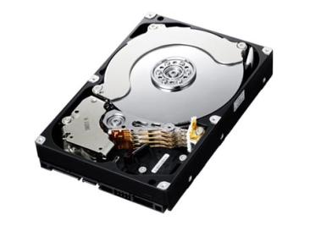
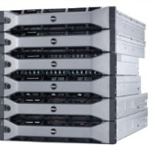
自动恢复型安全与合规解决方案
数据调度+安全功能
支持自加密硬盘
HDD硬盘和固态硬盘
“静止数据”加密 (DAR)
保护数据免因硬盘、盘柜或整体阵列丢失或被盗而遭受侵害
具备重要的FIPS 140-2认证资质
支持SC8000、S40、SC4020和SC9000
在以下客户之中发展自加密硬盘市场
政府
医疗
商业/零售
服务提供商
金融机构
渐进地使用自加密硬盘
–无需断代升级
VM主机和VLAN
外部重要管理器选项
与现有的SC硬件兼容
安全擦除
为已锁定/未锁定的文件夹提供分离的页池
非自加密硬盘
自加密硬盘
固态硬盘
HDD硬盘
Notes:
Highlight ability to mix secure/non-secure drives in same array
Key competitive advantage – lets customers make incremental move to SEDs
-----------
As recent security breaches in both government and private sector environments make headlines, organizations of all kinds are focusing on data protection. One of the most promising, growing technologies for safe-guarding information is the new generation of Self-Encrypting Drives (SEDs). These devices offer rock solid data protection even in cases where a drive or an entire array is physically stolen or lost. Drives removed from a system are automatically locked, and remain 100% inaccessible without their individual encrypted key, even if dissembled and placed on a “disk spinner.”
Dell Storage Center arrays now support a wide range of SED drives in both HDD and high-performance SSD formats, offering a trusted “data-at-rest” encryption solution that meets the most stringent compliance requirements, including the critical FIPS 140-2 certification required for sales into secure government datacenters. Leading remote key management platforms are supported, allowing large enterprise customers to leverage existing key management investments.
As always, Dell has found innovative ways to make this leading technology more affordable and practical for customers. While other solutions require customers to switch all their drives to SEDs, Dell’s unique ability to support SED and non-SED drives in the same array lets customers adopt a “pay as you go” approach to encryption. Secure drives may be deployed only for the volumes that require encryption. Separate page pools for locked and unlocked folders within the array provide complete separation and security, allowing for an incremental, cost-effective SED roll-out. Best of all, the new SC 6.x software lets customers deploy SEDs in their existing Storage Center or legacy Compellent arrays, contrasting with other vendors who require a forklift upgrade to entirely new hardware.
In addition, don’t forget the cost-saving efficiency of Storage Center Data Progression applies to SEDs – ensuring customers get maximum value from their investment. [Similar to SSD message]
Target markets
Healthcare, Fed space, Financial, Banking and Education
Larger Enterprise Customers with Remote Key Management Servers in place

Slide 32
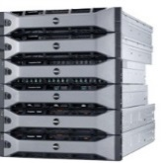
将网络虚拟化技术延伸到阵列
部门
服务提供商
在一个iSCSI端口上区分VLAN流量的新功能
SC链路自动响应QoS和安全政策的变化
支持64倍数量的有标签VLAN，并提供充分的故障转移保护
SC8000、S40、SC4020和SC9000
服务提供商能够…
在每台SC上托管更多客户
按不同的QoS水平收费
大型企业能够…
为QoS、安全或管理的目的划分多个部门
VLAN 14
客户公司
VLAN 23
VLAN 31
VLAN 62
财务
不同的QoS水平
交换机
通过网络QoS和安全政策，自动实现合规性
64 将享有安全保障的部门或客户的数量增加64倍
Notes:
Storage Center’s iSCSI network interface may now be used to provide segmented, controlled access for multiple VLANs per SC port or failover port grouping. Previously, the number of VLANs was limited to the number of physical fault domains configured on a Storage Center system – i.e., one VLAN per fault domain. Now a single port group can support up to 64 VLANs – each of which receives full physical failover protection.
This capability gives service providers a convenient, cost-effective method to securely host data for multiple clients on the same array, while charging the clients for variable QoS levels. It also benefits large corporations and other organizations who wish to use VLANs to separate departments for internal “charge-back,” security or administrative purposes.
With Multi-VLAN support, Storage Center automatically responds to QoS and Security policy changes in the main network. Once configured using the included wizard, SC links automatically inherit network VLAN policies – a significant advantage for both ease of administration and avoidance of costly security policy errors.

Slide 33
关于6.x版的 更多技术背景信息

Slide 34
压缩–更多细节
可使用Enterprise Manager逐卷压缩数据
在创建卷的期间启用压缩功能，或在以后将压缩功能增加到已有的卷之中
全局和卷级管理控制
压缩功能中止，不造成数据量回弹
选中的卷和全部兄弟卷保持压缩状态，但不会有页被进一步压缩
压缩功能禁用，造成数据量回弹
会导致选中的卷和全部兄弟卷在下一次数据调度进程中数据量回弹
查看已被压缩的卷数据的比例 (根据存储类型)
独立控制源卷和目标卷(LV和复制)
充分镜像的设置，或者…
根据公司不同地点的成本节约策略，采用不同的压缩水平
充分兼容其他Storage Center功能特性
快照可包含已压缩的数据
View Volumes可包含已压缩的数据
数据量回弹期间最小的读延迟
只在具有充足的空间来容纳整个卷的情况下，数据量回弹才会发生
如果没有足够的可用空间，将抛出警示

Slide 35
同步Live Volume / LXR复制功能的增强情况 –更多细节
增强功能的类型
一对Live Volume阵列以内、多个卷之间的同步复制
继续以阵列为单位进行数据调度 (节约成本)
跨多个地点的系统配置可以彼此不相似
在异步高可用、同步高可用和同步高一致模式之间动态变更
从Enterprise Manager内部手动激活/恢复Live Volume
支持第三个灾难恢复站点 – Live Volume Managed Replication
支持更强劲的灾难恢复计划
能够激活二级存储上的卷
能够复原原始主存储上的卷
现在已能复制到第三个灾难恢复站点
Live Volume Managed Replication
目标市场
德国、欧洲、中东与非洲地区
VMware SRM客户
供应EMC vPLEX和NetApp MetroCluster的地区

Slide 36
自加密硬盘–更多细节
保护数据免受以下情况的损害
硬盘丢失、转移或被盗
整个机箱被盗
整个Storage Center系统被盗
无后门：密钥丢失=100%数据丢失，不可恢复
锁的密钥是安全的，无法通过外部网络绕道
从系统移除或被盗的硬盘会自动锁定
即使盘身(platter)被放置在转轴支架(spin stand)上，数据仍是安全的
自加密硬盘+FIPS硬盘的功能特性
硬盘包含256-bit AES加密密钥和访问解锁密钥
还可在非自加密硬盘模式下运行，对系统不造成影响
即时密码擦除
在解除硬盘任务时实施
逐个硬盘提供密码擦除功能
Notes:
SEDs are FIPS 140-2 (Federal Information Processing Standards) Certified meeting government security standards.
There are many FIPS certifications but by far the most important to the government market is FIPS 140-2 because FIPS 140-2 Validation is required for sale of products implementing cryptography to the Federal Government. If you don't have FIPS 140-2 Validation for your product, and can't show that you are going to be obtaining it, you will not be able to access the government market with your products.
FIPS 140-2 defines the security requirements for cryptographic modules and identifies eleven areas for a cryptographic module used inside a security system that protects information.

Slide 37
自加密硬盘–更多细节(续)
要求
每台Storage Center阵列具备加密软件许可
兼容Dell FIPS的自加密硬盘
外部密钥管理服务器(KMS)
必须具备已有的Key Manager或者购买一个以便于支持该解决方案。
戴尔不会出售，但可推荐经测试的/兼容的产品。
仅限远程密钥管理(无本地密钥管理)
为冗余的(高可用或集群化)外部密钥管理器提供互操作支持
SafeNet K460/K250/K150v
Thales (基于IBM Tivoli Key Lifecycle Management一体机(+HA) – 2014年12月
IBM Tivoli (未来)
EMC RSA (未来)
其他(未来)
市面提供的FIPS自加密硬盘
300GB 15K, 2.5”
600GB 15K, 2.5”
1TB, 7K, 2.5”
1.2TB 10K, 2.5”
4TB 7K, 3.5”
6TB 7K, 3.5”*
即将变更
9月18日
1.8TB 10K, 2.5”
1.6TB写密集型固态硬盘, 2.5”
11月9日
6TB 7k, 3.5”*
2016日历年第一季度
1.92TB
Notes:
KMIP client (Cryptsoft, OASIS v1.0 compliant)

Slide 38
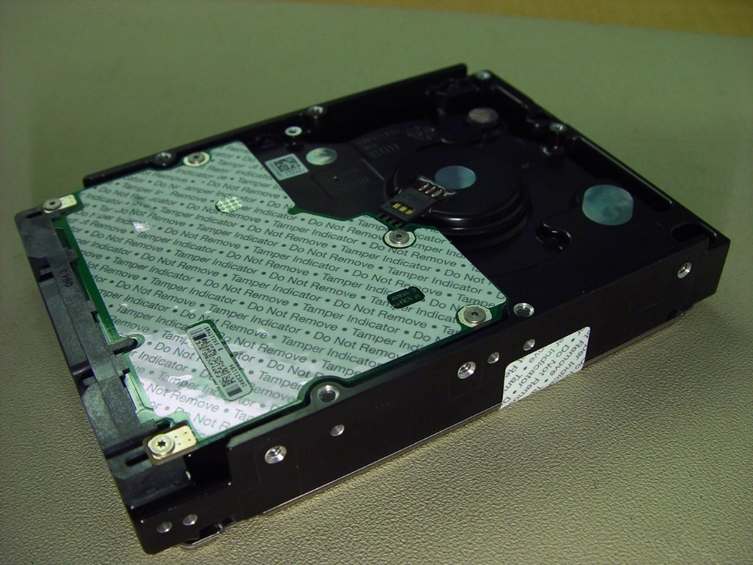
自加密硬盘: 联邦信息处理标准– FIPS
FIPS 140-2 Level 2
Meets requirements for physical tamper-evidence and role-based authentication.
Notes:
The National Institute of Standards and Technology (NIST) issues the 140 Publication Series to coordinate the requirements and standards for cryptographic modules which include both hardware and software components for use by departments and agencies of the United States federal government.
SEDs are FIPS 140-2 (Federal Information Processing Standards) Certified meeting government security standards.
There are many FIPS certifications but by far the most important to the government market is FIPS 140-2 because FIPS 140-2 Validation is required for sale of products implementing cryptography to the Federal Government. If you don't have FIPS 140-2 Validation for your product, and can't show that you are going to be obtaining it, you will not be able to access the government market with your products.
FIPS 140-2 defines the security requirements for cryptographic modules and identifies eleven areas for a cryptographic module used inside a security system that protects information.

Slide 39
SCOS 的加密选项 静态数据和动态数据
加密选项
驱动器选项
只需要主要的管理应用
SED 硬盘
SafeNet Key Secure
使用自加密硬盘
静态数据加密
SED 固态硬盘
Thales EMS
驱动器选项
加密软件 + 主要的管理应用
使用非自加密硬盘
动态数据加密
标准硬盘
SafeNet ProtectFile
标准固态硬盘
Vormetric

Slide 40
SCOS 对自加密的支持 Data-At-Rest Encryption Management Server Solution
加密解决方案
驱动器(传统硬盘/固态硬盘) + 自加密软件许可证 + 主要的管理服务器 (KMS)
微软提供
SafeNet KMS 解决方案(通过Dell S&P )
k460
k250
k150v
弹性的一体化应用，带有冗余的热插拔硬盘和电源
FIPS 140-2, 3级认证的安全
为大型环境提供至关重要的安全管理
预算比较紧张，有冗余设计和较低级别的FIPS认证
需要在虚拟化数据中心或公共云环境中拥有低成本的关键管理
需求低于全面的3级 FIPS 认证

Slide 41
Multi VLAN Tagging – 更多细节
每个端口或容错域支持多达64个 VLAN
VLAN ID 的范围从1-4094
VLAN 端口是唯一目标
VLAN能够随时创建和撤销
能够从VLAN增加和移除端口，不会对其它VLAN造成影响
Ports can be added/removed from VLAN without affecting other VLANs
VLAN 能够同时支持Tagged Traffic和Untagged Traffic
要求:
用于Storage Center控制器的Chelsio 10Gb I/O 卡
SC8000 或40系列上的SC v6.5
Enterprise Manager
仅用于虚拟端口 (新) 模式
Notes:
VLANs are grouped into Fault Domains. Fault Domains enable physical separation of ports in a system
Total number of VLANs in a system is the product of the number of Fault Domains in the system times the number of VLANs in each Fault Domain

Slide 42
VLANs、容错域和虚拟端口
之前，由于每个SC物理端口只能支持一个VLAN，每个物理容错域也只能支持一个VLAN。
利用SC 6.5，VLAN 流量现在可以在独立的iSCSI端口上被分割，这意味着多达 64个 VLAN能够“分享”1个物理容错域。
1
容错域为单个VLAN提供故障转移保护
1
2
3
4
5
…64
每个物理端口支持高达64个虚拟端口
所有的VLAN都能得到全面的故障转移保护
容错域
容错域
1
2
3
4
64倍以上的VLAN
容错域
容错域
4个容错域的配置
容错域
容错域
容错域
容错域
对于有多个容错域配置的整体SC系统来说，这限制了VLAN的数量。
容错域
容错域
利用6.5，典型的SC 配置现在能够支持64倍多的VLAN
背景仅用于展示，为了使动画更清晰
Notes:
[INTERNAL SLIDE to help presenters understand previous and new relationship of VLANs to Storage Center 容错域s.]

